Slide 2
Topic 1
Change Happens

Slide 3
Two Basic Assumptions About One Another…
I assume that you are not a narrow-thinking, close-minded, past grabbing Neanderthal.
You assume that I believe in the foundations of the faith, serve Christ, love the church, and believe we are all about reaching lost people for Jesus.

Slide 4
Change Happes
“We shouldn’t use farm models to manage a factory economy, and we shouldn’t use factory models to manage an office economy.”
Stanley David, In Future Perfect

Slide 5
Simply Put: The Environment Has Changed
Change Happens
 | Pre Industrial | Industrial | Post Industrial
Outcomes | Produce | Products | Processes
Markets | Local | Mass | Individual
Focus | Farmer | Worker | Customer
Expansion | Exports | Segments | Tribes
Limits | Physical | Transport | Growth Capacity
Works | Repeated Past | Repeated Present | Anticipating the Future
Structures | Individual | Hierarchies | Networks

Slide 6
Change Happens
“Despite the activity and chutzpah emanating from thousands of congregations, the Church in America is losing influence and adherents faster than any other major institution in the nation .”
George Barna, In The Second Coming Of The Church

Slide 7
However: The More Things Change…
Change Happens
1880-1915 | 1980-2015
Rise of fundamentalism | Power of fundamentalism
First Wave – experiential religion | Third Wave – experiential religion
Bible Schools | Parachurch
Social Gospel | Gospel & Justice
Decline of Mainline denominations | Wider Christian church decline
1880-1915 | 1980-2015
Growth of cults | Growth of eastern religion
Christian publishing flourishing | Electronic church
Mass people movements | Mass people movements
Changes in communication | Hmmm.
Global survival issues | Global survival issues

Slide 8
Change Happens
“Strangely enough, this is the past that someone in the future is longing to go back to.”
Asheigh Brilliant

Slide 9
Four Change Elephants
Change Happens
The Global Marketplace
We exist, work, and witness in an uncertain, unstable, global marketplace whether we like it or not.

Slide 10
Four Change Elephants
Change Happens
The Global Marketplace
The Collapse of Time
In order to “get the job done” and get it done on budget, we squeeze more productivity out of fewer people in less time. The mantra is “Go fast or go broke.”

Slide 11
Four Change Elephants
Change Happens
The Global Marketplace
The Collapse of Time
Universal Access
The global village, tied together by complex communication systems gives us more access and more information than we can process or synthesize. It is information overload.

Slide 12
Four Change Elephants
Change Happens
The Global Marketplace
The Collapse of Time
Universal Access
Change Acceleration
The only constant in the marketplace is rapid change. The pressing need for individuals and organizations to adapt and change is unprecedented.

Slide 13
Change Happens
“A transformational period, like a tidal wave, builds up massive amounts of energy and releases it upon society. When it subsides, the boundaries of the former epoch are changed permanently, and all socio-cultural structures and institutions have been reshaped.”
Regele, in Death Of The Church
“As the institutional church faces the unfolding of the twenty-first C., it faces a great challenge. The church’s message is simply one more voice in a cacophony of created realities competing to attract a following. This will not change. It is in engaging what this means that the church again comes face to face with its own death .” Mike Regele, In The Death Of The Church

Slide 14
Topic 2
Why People Resist Change

Slide 15
Why People Resist Change
“The first principle is that resistance to change is natural and inevitable. To think that it won’t occur, or to view those who exhibit its symptoms as difficult or retrograde is a fatal mistake… In fact, resistance to reengineering change is a sign that something significant is happening.”
Mike Hammer in The Reengineering Revolution

Slide 16
Reasons For Resistance
Why People Resist Change
1. Change means giving up something.
2. Holding on to the old gives a greater sense of control.
3. Resisting change can be a way of getting revenge.
4. Resistance to change may be a well intentioned effort to stop a perceived mistake.

Slide 17
Why People Resist Change
“Subconsciously, they have so closely identified their personal agenda with the current state of the organization that they sincerely believe that fundamental change would not just be bad for them personally, but in fact be a disaster for the company as a whole.”
Mike Hammer in The Reengineering Revolution

Slide 18
Reasons For Resistance
Why People Resist Change
5. Lack of understanding.
6. Perceived efficiency and effectiveness of the current organization.
7. People move from discomfort to comfort, not the other way around.
8. Change threatens our self-esteem by requiring new skills that we don’t have.

Slide 19
Electromagnetic Induction: Lenz’ Law – “the most human of the laws of physics” We Resist Change
Why People Resist Change
Magnet Moving
Downward
Magnet Moving
Downward
Induced Current
Magnetic Field
Current Creates Opposing Magnet Field

Slide 20
Why People Resist Change
If few people want change (even though it is inevitable…) what forces it to still occur?

Slide 21
Why Change Occurs…
Why People Resist Change
1. Pressure of outside events.
2. Financial exigencies.
3. Need for organizational development.
4. A lack of ministry success.
5. A loss of vision.
6. A lack of ability from leaders leads to “revolution.”

Slide 22
Why People Resist Change
Rule of Thumb 1:
The larger the environmental change, the larger the associated ministry change needs to be.
Rule of Thumb 2:
There is always more than one reason why change occurs.

Slide 23
Why People Resist Change
Rule of Thumb 3:
We do more damage than good by resisting change:
we look close-minded;
it hurts the chances of success;
it is a losing effort.
“In a fight between you and the world… bet on the world.”
Franz Kafka

Slide 24
Why People Resist Change

Slide 25
Why People Resist Change
Myths About Change:
Myth | Reality
This change will go away. | No it won’t.
It will help if I get upset about this. | Controlling ourselves helps with situational control.
I can keep doing what I have always been doing. | If the organization changes, you better as well.
Problems that arise will prove this was a wrong decision. | Problems are the side-effect of change.

Slide 26
Why People Resist Change
Myths About Change:
Myth | Reality
They aren’t telling us everything | They probably don’t know either.
Leadership doesn’t care about people. | Change does effect people, and always will.
Leaders are supposed to make this work, not me. | If you are not part of the solution, then you are part of…
They don’t know what they are doing | Not a myth.

Slide 27
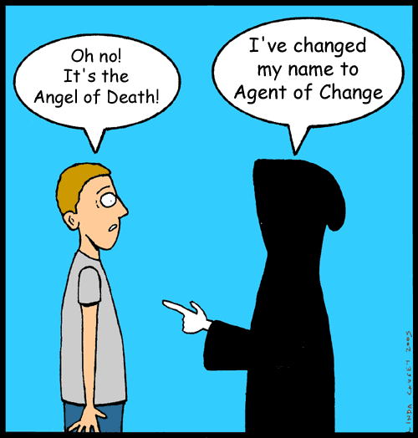
Why People Resist Change
“Non-profit organizations are… human change agents.”
Peter Drucker in Managing The Non-Profit Organization
“A leader is, by definition, an innovator… Learning to lead is learning to manage change.”
Warren Bennis in On Becoming A Leader

Slide 28
Topic 3
Theology of Change

Slide 29
Theology of Change
Biblical Principles of Change:
1. In the Bible, change is often pragmatically driven; not about spirituality.
David & Goliath (David’s approach to the battle)
Acts 6:1-7 - taking care of widows
Acts 20:17-35 - elders to take care of the church
Structural change was not a big issue

Slide 30
Theology of Change
Biblical Principles of Change:
2. In the Bible, change can be pragmatically driven (sometimes by us, sometimes at us), but proves to ultimately have a spiritual purpose.
Moses - takes Israel out of Egypt to become worshippers; REASON: Loss of favoured position - Ex. 1:6-8 (and maybe direction from God?)
Mordecai & Esther
Acts 11:19-21 - persecution
Colossians 2:6-8; 2:16-3:4 - Movement away from regulations to freedom in Christ, a discussion forced by the realities of pagan backgrounds.

Slide 31
Theology of Change
Biblical Principles of Change:
3. In the Bible, change is about doing effective ministry within a particular generation.
Acts 13:36 - David served in his own generation.

Slide 32
Theology of Change
Biblical Principles of Change:
4. In the Bible, change is primarily personal - before it is ever corporate
Paul’s personal transformation - Acts 9:19-31
Paul’s personal “change” while in prison

Slide 33
Theology of Change
Biblical Principles of Change:
5. Often, these reasons for change are intertwined.
Acts 15: 1, 22-35 - Driven by the reality of uncircumcised Gentile believers, the church changed at its core. This included pragmatic reality, the work of the Spirit, the spreading of the gospel, and God’s work in individuals before it became public.

Slide 34
Topic 4
Contemporary Models of Change

Slide 35
Models of Change
John Kotter’s Eight Stage Process:
1. Establish A Sense Of Urgency
Examine the market and competitive realities
Identify and discuss crises, potential crises, or major opportunities.
WHAT IS THE ETHICAL DANGER HERE?
“Never underestimate the magnitude of the forces that reinforce complacency and help to maintain the status quo.”

Slide 36
Models of Change
John Kotter’s Eight Stage Process:
2. Creating The Guiding Coalition
Put together a group with enough power to lead the change?
Get the group to work together like a team.
HOW DO YOU AVOID EGO FILLED PEOPLE AND “SNAKES”?
“Personnel problems that can be ignored during the easy times can cause serious trouble in a tougher, faster moving, globalizing economy.”
Notes:
!

Slide 37
Models of Change
John Kotter’s Eight Stage Process:
3. Developing A Vision and Strategy
Create a vision that helps direct the change effort.
Develop a strategy for achieving the vision.
HOW DO YOU CREATE VISION IN A WAY THAT BUILDS UP, RATHER THAN TEARING DOWN?
“Vision creation is almost always a messy, difficult, and sometimes emotionally charged exercise.”
Notes:
!

Slide 38
Models of Change
John Kotter’s Eight Stage Process:
4. Communicating The Change Vision
Use every vehicle to constantly communicate.
Model the expected change.
WHAT IS THE RISK IN HAVING COMMUNICATION A TWO-WAY DIALOGUE?
“Nothing undermines the communication of a change vision more than behavior on the part of key players that seems inconsistent with the vision.”
Notes:
!

Slide 39
Models of Change
John Kotter’s Eight Stage Process:
5. Empower Broad Based Action
Get rid of obstacles.
Change systems that undermine the vision.
Encourage risk taking and non-traditional thinking.
WHY IS THIS HARDER THAN IT SOUNDS?
“Discouraged and disempowered employees never make enterprises winners...”
Notes:
!

Slide 40
Models of Change
John Kotter’s Eight Stage Process:
6. Generate Short Term Wins
Plan for visible improvements.
Create wins & reward the appropriate people.
“To some degree, all management is manipulation -- and that includes the production of short-term performance improvements.”
Notes:
!

Slide 41
Models of Change
John Kotter’s Eight Stage Process:
7. Consolidate Gains and Produce More Change
Hire, promote, develop people who implement change.
Re-invigorate the process.
THIS IS A LONG ROAD -- HOW APPLICABLE IS IT TO THE CHURCH?
“Decades, or even centuries can be meaningful time frames...”
Notes:
!

Slide 42
Models of Change
John Kotter’s Eight Stage Process:
8. Anchor New Approaches In The Culture
Articulate connections between success & behaviours.
Develop means of ensuring succession.
CAN WE ADJUST THE NEW CULTURE? How hard is this?
“The basic conception of the proposal -- to get in there and hammer the culture into shape -- made success virtually impossible from the outset.”
Notes:
!

Slide 43
Models of Change
SYSTEM Warnings!!!
Systems don’t always work in real life!
Don’t underestimate the rigidity of people.
Don’t underestimate the work of the Holy Spirit.
Notes:
Pause for a word from our sponsor...

Slide 44
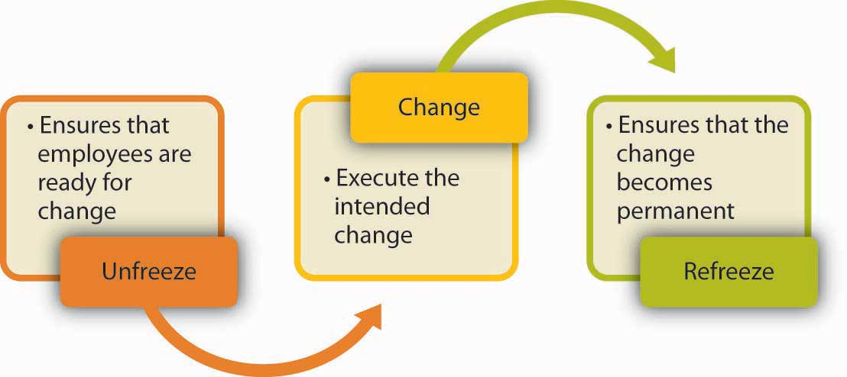
Models of Change
Kurt Lewin’s Three Phases of Change:
Notes:
!

Slide 45
Models of Change
Kurt Lewin’s Three Phases of Change: UNFREEZE
We could issue an edict - guarantees huge resistance.
We could involve ALL the stakeholders - mediocre plan that is time consuming and leads to divided responses.
We could begin the process with a limited number of people.
OPTIONS
Notes:
Edict - telling what change will be
Stakeholders - many meetings with many responses
Limited number...

Slide 46
Models of Change
Kurt Lewin’s Three Phases of Change: UNFREEZE
Advantages to beginning with a smaller number of people:
Allows for a clear plan.
Can then involve the stakeholders
Can listen to feedback, involving people in the removing obstacles and refining.
PRIME ASSET: It allows leaders to lead while including people in the process.
Notes:
Edict - telling what change will be
Stakeholders - many meetings with many responses
Limited number...

Slide 47
Models of Change
Kurt Lewin’s Three Phases of Change: UNFREEZE
Understanding Lewin’s Force Field:
Status Quo is maintained because there are equal forces acting against change.
There are “driving forces” and “restraining forces”
THE GOAL is to change the force in some direction.

Slide 48
Models of Change
Kurt Lewin’s Three Phases of Change: UNFREEZE
Understanding Lewin’s Force Field:
Goal: Team Effectiveness
DRIVING FORCES
RESTRAINING FORCES
Performance Standards
Inadequate Leadership
STATUS QUO
Care For others
Unmet personal needs
Clear Goals
Poor communication

Slide 49
Models of Change
Kurt Lewin’s Three Phases of Change: UNFREEZE
Altering the Force Field:
Option 1: Increase the strength of a driving force
DRIVING FORCES
RESTRAINING FORCES
Performance Standards
Inadequate Leadership
STATUS QUO
Care For others
Unmet personal needs
Clear Goals
Poor communication

Slide 50
Models of Change
Kurt Lewin’s Three Phases of Change: UNFREEZE
Altering the Force Field:
Option 1: Increase the strength of a driving force
This Is The Least Desirable Method, since it adds stress to the entire system, forcing change without any balance.
Notes:
Tends to make people unhappy, in some cases because the increased force is negative, not positive.
IE - Worship style change; Push the levels of contemporary music

Slide 51
Models of Change
Kurt Lewin’s Three Phases of Change: UNFREEZE
Altering the Force Field:
Option 2: Remove one or more restraining forces
DRIVING FORCES
RESTRAINING FORCES
Performance Standards
Inadequate Leadership
STATUS QUO
Care For others
Unmet personal needs
Clear Goals
Poor communication
Notes:
Sometimes this is very possible.

Slide 52
Models of Change
Kurt Lewin’s Three Phases of Change: UNFREEZE
Altering the Force Field:
Option 2: Remove one or more restraining forces
This Can Be A Good Option, but it can also be painful. Remember that the restraining force may be a person!
Notes:
ILL: Worship Team stuff?

Slide 53
Models of Change
Kurt Lewin’s Three Phases of Change: UNFREEZE
Altering the Force Field:
Option 3: Turn a restraining force into a driving force
DRIVING FORCES
RESTRAINING FORCES
MEET personal needs
STATUS QUO
Inadequate Leadership
Performance Standards
Unmet personal needs
Care For others
Poor communication
Clear Goals

Slide 54
Models of Change
Kurt Lewin’s Three Phases of Change: UNFREEZE
Altering the Force Field:
Option 3: Turn a restraining force into a driving force
This The Best Option, but it can require time, effort, sensitivity, and compassion. If a restraining force is a person, then it can be a long, hard change.

Slide 55
Models of Change
Kurt Lewin’s Three Phases of Change: UNFREEZE
Altering the Force Field:
WHAT ARE SOME WAYS TO CHANGE A RESTRAINING FORCE IN A CHURCH INTO A DRIVING FORCE?
Take a few minutes, and discuss a real life scenario in one of your ministry environments where change needs to occur. Be prepared to tell us the opposing forces, what needs to change, and what is your strategy for doing so.

Slide 56
Models of Change
Kurt Lewin’s Three Phases of Change:
Notes:
!

Slide 57
Models of Change
Kurt Lewin’s Three Phases of Change: TRANSITION
When people begin to move (unfreeze), then they will typically go through four stages of attitude adjustment.
These stages are NOT precise.
These stages tend to blur with the three phases of change.
The speed of transition depends upon the responses, methodology, and attitude of the change agent.

Slide 58
Models of Change
Kurt Lewin’s Three Phases of Change: TRANSITION
4 Stages of Transition:
Stage 1: Uninformed Optimism
People are eager for change, and prepared to go forward. They have unrealistic expectations and some anxiety about change.
Response 1: Give Information
Tell as much as possible about how the change will work, and what will happen.

Slide 59
Models of Change
Kurt Lewin’s Three Phases of Change: TRANSITION
4 Stages of Transition:
Stage 2: Informed Pessimism
People begin to feel out of control, and morale begins to dip. Problems grow, and if appropriate responses are not given, high resistance forms.
Response 1: Address Personal Issues
Explain how this will affect the individual, and how it will be beneficial or detrimental to their well being.

Slide 60
Models of Change
Kurt Lewin’s Three Phases of Change: TRANSITION
4 Stages of Transition:
Stage 2: Informed Pessimism
People begin to feel out of control, and morale begins to dip. Problems grow, and if appropriate responses are not given, high resistance forms.
Response 2: Answer Management Issues
Respond to questions of how the change will start, be managed, and be organized.

Slide 61
Models of Change
Kurt Lewin’s Three Phases of Change: TRANSITION
4 Stages of Transition:
Stage 2: Informed Pessimism
People begin to feel out of control, and morale begins to dip. Problems grow, and if appropriate responses are not given, high resistance forms.
Response 3: Explain Consequences
Tell why the change is meaningful, and worth the effort. Explain the cost for not making these changes.

Slide 62
Models of Change
Kurt Lewin’s Three Phases of Change: TRANSITION
4 Stages of Transition:
Stage 3: Hopeful Realism
People are becoming responsive and moving towards a resolution. They provide critical, constructive feedback and begin looking towards a positive outcome.
Response 1: Allow Collaboration
Encourage people to get involved in the process, and ensure they have meaningful roles to play.

Slide 63
Models of Change
Kurt Lewin’s Three Phases of Change: TRANSITION
4 Stages of Transition:
Stage 4: Informed Optimism
Details are being finalized, with new routines and procedures in place. Feedback and incremental change continues.
Response 1: Refocus
Continue to link the change to the bigger vision. Attempt to create a bigger picture than just the immediate change.

Slide 64
Models of Change
Kurt Lewin’s Three Phases of Change: REFREEZE
As change begins to be settled, the systems must be reintegrated.
Generally as change comes to an end, another is already on the horizon.
IMPORTANT: DO NOT WALK AWAY BEFORE THE JOB IS DONE. IT CAN TAKE A LONG TIME TO REFREEZE A NEW CULTURE.

Slide 65
Models of Change
“New paradigms put everyone practicing the old paradigm at risk. And the higher one’s position, the greater the risk… If you are doing well using the old paradigm, it makes no sense whatsoever to turn around and put yourself out of business by creating a new set of rules.
Joel Barker in Discovering The Future

Slide 66
Models of Change
SO WHAT???
Change is predictable and can be managed.
Change is even predictable enough to be planned for (in some cases).
We don’t have to flounder through change -- it is the mark of incompetence, not the mark of leadership.
Change will always hurt - but we can choose our pain.

Slide 67
Topic 3
Altering the Dynamics of Change

Slide 68
Leadership and Change
“Leadership is not a maintenance role. One cannot lead people or things to where they already are. The status quo cannot be the goal or the purpose… Truly effective leaders are change agents, constantly repositioning people, programs, resources, objectives and whole organizations to accomplish their institutional purpose.”
Daniel Brown

Slide 69
Leadership and Change
Helping Other to Take Risks and Change:
Per Daniel Brown, in Leadership is All About Change
Convert the change issue to a felt need or mutual purpose.
Show how the change better accomplishes the mutually agreed upon vision.
Show how commonly held values can only be realized through change.
Be interactive – listen and talk.

Slide 70
Leadership and Change
Helping Other to Take Risks and Change:
Per Daniel Brown, in Leadership is All About Change
Be flexible – willing to modify the how in order to accomplish the what.
Get people involved in the change – they will change more when they experience it.
Allow people to reserve judgement.
Set an evaluation date, where the changes can be discussed and reconsidered.
Model the change you want to make.

Slide 71
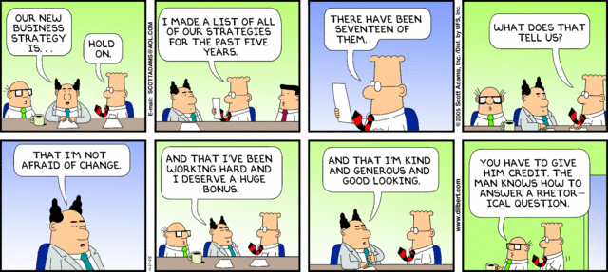
Leadership and Change
Helping Other to Take Risks and Change:
Per Daniel Brown, in Leadership is All About Change
Don’t waver.
Don’t take criticism personally.

Slide 72
Leadership and Change
In Order to Change, Leaders Need Extraordinary Levels of:
Per Hesselbein, in The Leaders of the Future
Perception and insight into the realities of the world, and themselves.
Motivation, in order to get through the levels of pain, learning, and loss of loyalty.
Skills for analyzing cultural assumptions and dysfunctions.
Emotional strength, to manage their own and other’s anxiety.
Ability to build empowered, knowledge-based work teams because tasks will be too complex and information too widely distributed.

Slide 73
Leadership and Change
“Show me a great company, and I’ll show you one that has radically changed itself and is looking forward to the opportunity to do so again.”
Larry Bossidy, CEO of Allied Signal

Slide 74
Leadership and Change
Ten Rules for Stifling Change:
Per Lou Pritchett, in Stop Paddling and Start Rocking the Boat
Regard any new ideas from “below” with suspicion.
Insist that people must go through layers of management to get your permission to do anything.
Express criticism freely, and withhold praise.
Treat identification of problems as a sign of failure.
Control everything carefully.
Secretly make decisions to reorganize everything or to change policies.

Slide 75
Leadership and Change
Ten Rules for Stifling Change:
Per Lou Pritchett, in Stop Paddling and Start Rocking the Boat
Follow the “need to know” rule. You never know when the right information might fall into the wrong hands.
Assign others the tasks of implementing any tough decisions you have made.
Operate on the assumption that nothing will work as well without you as it will with you.
Never forget that you know more than anybody else about the church and ministry.

Slide 76
Leadership and Change
Attitudes of a Change Agent:
Believe that God’s truth is eternal.
Believe that God is in control, not you.
Keep your own approach to people and issues under control. Do what is right, not what always feels right.
Take ownership of the changes.
“I don’t need yes men around me. I want everyone to tell me the truth even if it costs them their job.”
Sam Goldwyn

Slide 77
Leadership and Change
Attitudes of a Change Agent:
Be tolerant of mistakes. Well, some mistakes.
Invest in the future, rather than trying to redesign the past.
Keep your sense of humour.
“The question is not whether or not there will be change, but how much there will be and how quickly it will come.
Manuel London, in Change Agents

Slide 78
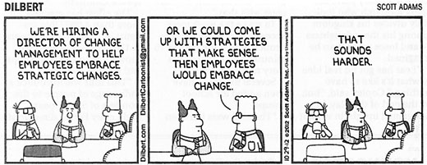
Leadership and Change

